Slide 1


DEPARTMENT OF ELECTRICAL & COMPUTER ENGINEERING
UNIVERSITY OF CENTRAL FLORIDA
Group 28
Karel Castex, Julio Lara, David Wade, Jing Zou

Slide 2

Motivations and Goals
Common interest in power system
Renewable energy
To optimize the battery charging efficiency and Maximize the cost return of an integrated wind and solar power system.

Slide 3
Objectives
Efficient
Small scaled
Self-sustained
User friendly

Slide 4
Requirements
Able to charging the batteries with variations
Consume as little power as possible
Safe to operate

Slide 5

Specifications
Solar Panel and Wind Turbine deliver > 12 V
Total System Power Output > 300 W
12 V Battery with > 10 Ah
Approximately 90% Efficient

Slide 6
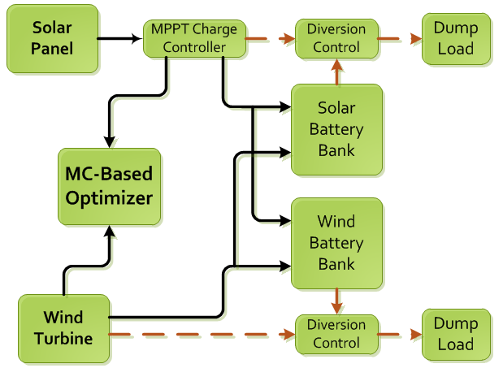
Overall Block Diagram

Slide 7
Switching Algorithm

Slide 8
Wind Generator: Alternatives
Model | THE WORKHORSE 250W | Hyacinth P-300W | Apollo 550W
Rated Power | 250W | 300W | 450W
Rated Voltage | 12 VAC | 12 VAC | 12 VAC
Starting wind speed | 6 m/s | 3 m/s | 3.5 m/s
Rated wind speed | 15 m/s | 12.5 m/s | 13 m/s
Price | $129 | $275 | $438

Slide 9
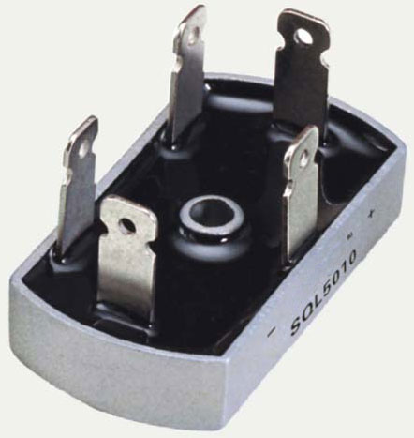
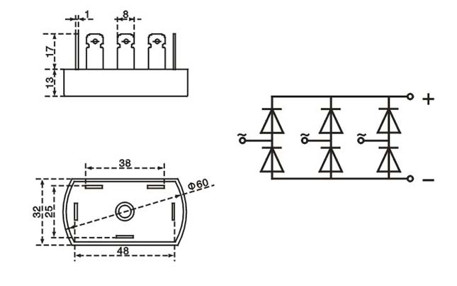
Wind Generator: Three-phase full-wave bridge rectifier Diode 50A 1000V
Model | VRRM | IO | @T | IFSM | IR | VFM | @IFM
 | V | A | ℃ | A | μA | V | A
SQL5010 | 1000 | 50 | 55 | 50 | 10 | 1.2 | 12.5

Slide 10
Photovoltaic Panels Types
 | SunWize SW-85P | Solarland SLP-085
Rated Power (W) | 85 | 85
Rated Voltage (Vmp) | 17.4 | 17.2
Rated Current (Imp) | 4.9 | 4.94
Open Circuit Voltage (Voc) | 22.0 | 21.6
Short Circuit Current (Isc) | 5.4 | 5.5
Weight (lbs) | 18 | 18.52
Cost | $249.85 | $260.00

Slide 11
Solar Charger with MPPT
 | Morningstar SS-MPPT | Solar Boost 2000e
Peak Efficiency | 97.5% | 95%
Nominal Battery Voltage | 12V to 24V | 12V to 24V
Maximum Battery Current | 15A | 20A
Current Consumption | 35mA | 90mA
Cost | $199.00 | $227.80

Slide 12
Switching Algorithm

Slide 13
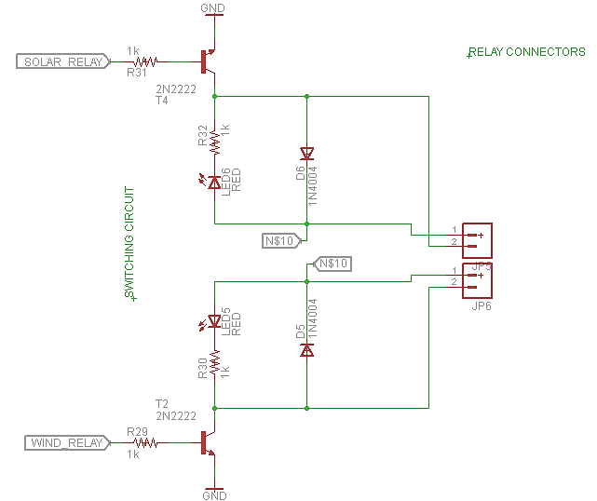
Switching Circuit

Slide 14
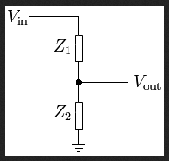
Voltage Monitoring
Voltage Divider
Output voltage of solar panel and wind turbine
From 0 – 3.3V
Low pass filter

Slide 15
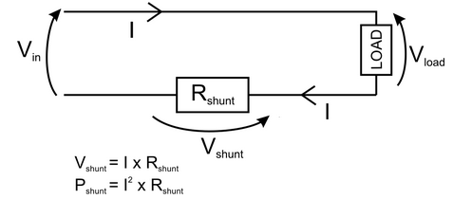
Current Monitoring
Modify invasive method
Current flowing through a small resistance
Small voltage drop will occur
Replace the shunt resistor with wire: 1.6698 Ohms

Slide 16
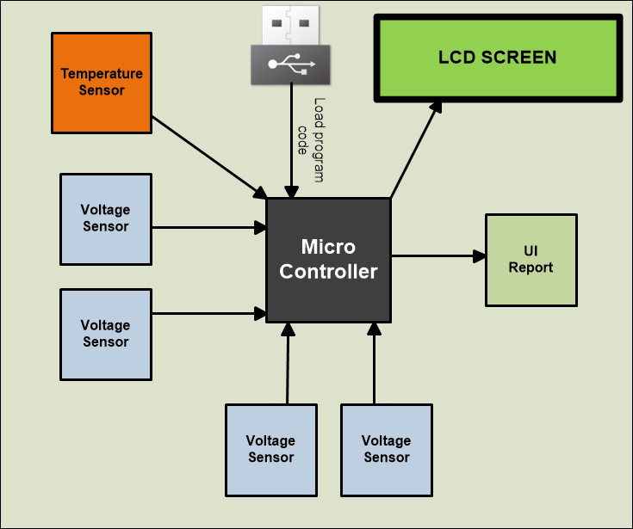
Controller Box
IRPS concept for encapsulation of making decision main components
Grouping linked actions to easily explain most IRPS functionality
Controller box important part of IRPS circuitry but not entire PCB design
Encompassed microcontroller, voltage, current, temperature sensor, LCD,USB-TTL interface, and UI Software

Slide 17
Microcontroller
Low Clock Frequency
Several Analog Inputs
PWM Output Pins
Serial UART Pins
Programming Debugging Feature
Programming Memory ≥ 16Kb
High Level Programming Language (Similar to C)
Convenient Software, Libraries, IDE
Desirable Good Community Support

Slide 18
Microcontroller
 | Atmel ATmega328 | Atmel AT91SAM7X512 | MSP430 (CC430) | PIC24F
Flash Memory | 32 Kb | 128 Kb | 32 Kb | 64 Kb
Clock Speed | 16 MHz | 48 MHz | 20 MHz | 20 MHz
Voltage | 5V DC | 3.6V DC | 3.6V DC | 3.3V DC
Digital I/O | 14 I/O (6 PWM), 6 Analog Input | 20 I/O (4 PWM,4 UART,SPI,I2C, 8 ADC Analog Input) | 30 I/O (6 ADC,2 UART,SPI,I2C,PWM) | 64 I/O (16 ADC,4 UART,SPI,I2C)
CPU | 8 bit | 32 bit | 16 bit | 16 it
Development | Arduino Board | Netduino Board | TI Dev. Board | Microchip Board
Prog. Language | Arduino (Similar to C) | C,C# | C | C,C++
IDE | Arduino IDE (Free) | Visual Studio (Free) | TI IDE (<16 Kb Free) | MPLAB IDE
Price | Board - $30, ATMega328 - $2.88 | Board - $34.95, AT91SAM - $14.06 | Board - $100 IDE- $200 if > 16Kb | Board - $70

Slide 19
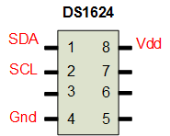
Temperature Sensor
 | TMP36 | DS1624
Supply Voltage | 2.7 – 5.5 V | 2.7 – 5.5 V
Connection | One analog input port | I2C Bus
Method | Voltage drop | Digital output buffer
Range | -40 °C to +125 °C | -55 to +125 °C
Price | $2 per unit | Free (Sample)

Slide 20
Switching Algorithm

Slide 21
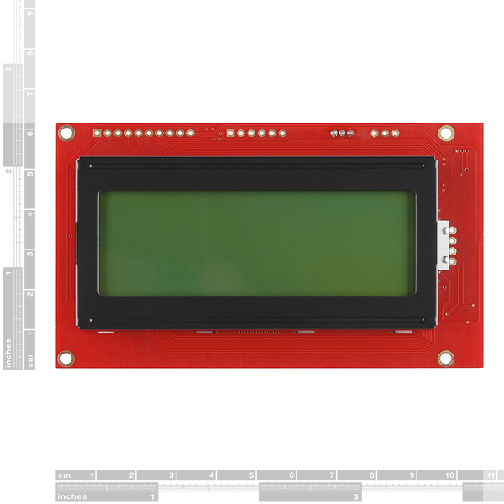
LCD
Serial Enabled 20x4 LCD – 5V
User definable splash screen
Embedded PIC 16F88 utilizes onboard UART for greater communication accuracy
VDD - 5V, GND - ground, RX and TX pins - AT91SAM7X512 UART Com1
LCD display IRPS important reading (Solar Panel Power, Wind Turbine Voltage, Current Mode of Operation, Both Batteries status, Controller box temperature).
Any alert or system running exception

Slide 22
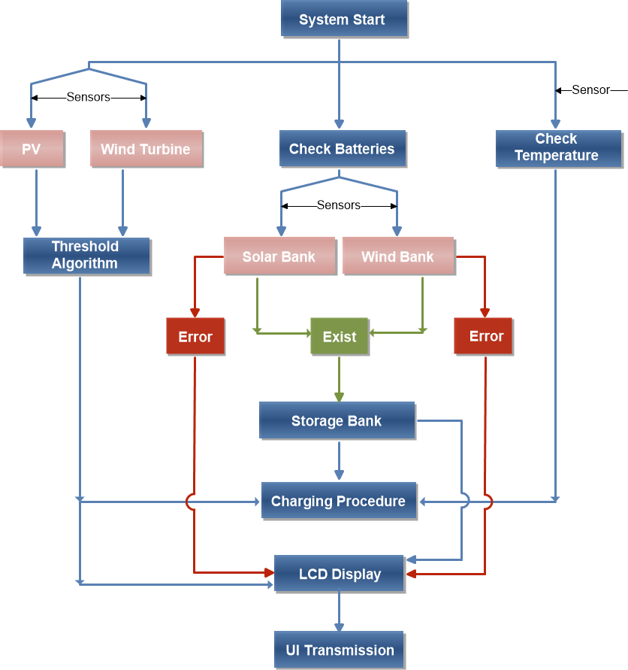
Functionality Diagram
Blue (boxes, arrows) means logical stages and system direction flow
Light red accent boxes describe physical components (interact with some stages)
Red (boxes, arrows) denote critical system errors status
Green (boxes, arrows) define successful checking of some components correct availability

Slide 23
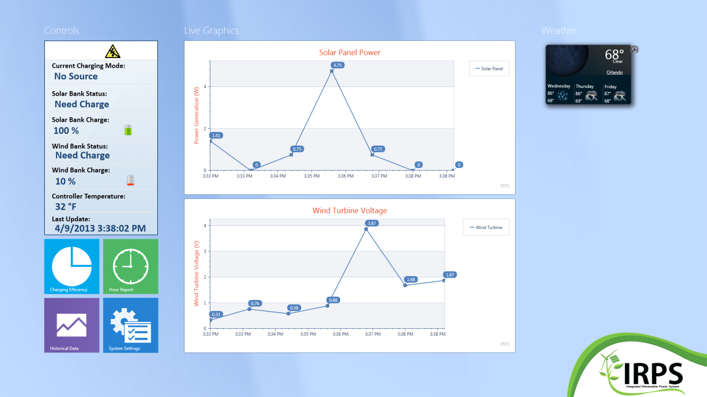
UI Interface Report
User friendly
Windows Presentation foundation platform (WPF)
Data transmitted through UART
Powered by SQL Server Compact database engine
Live data monitor, system current status, current weather, three analytical reports and system settings.

Slide 24
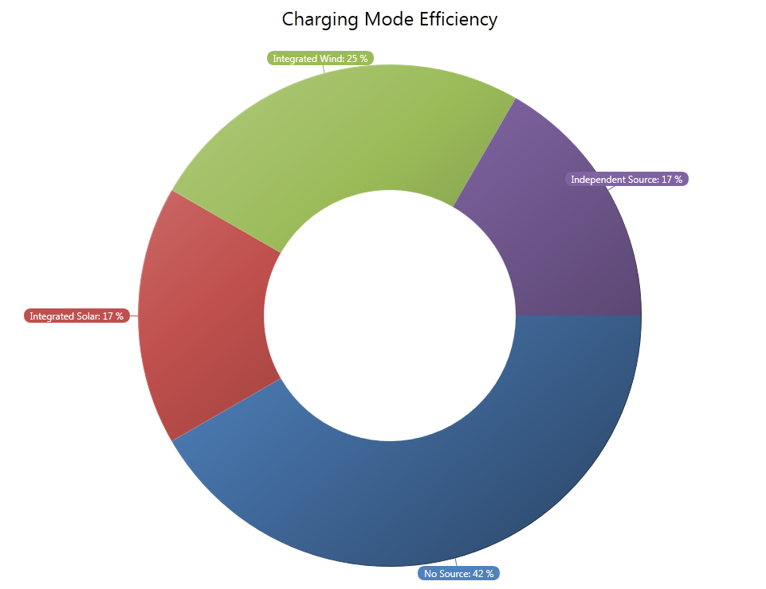
Charging Efficiency Report
Percentage of IRPS being at specific mode of charging
Filtered by date range option
Query software database to pull real time data
Clear indicator from best mode to operate at IRPS location

Slide 25
Diversion Charge Controller
To protect the battery from overcharging and over discharging
Monitor the battery voltage
Divert the power to the dump load
Charging window: 11.9-14.9V
Wind generator: Dump mode
Soar panel: Open circuit mode

Slide 26
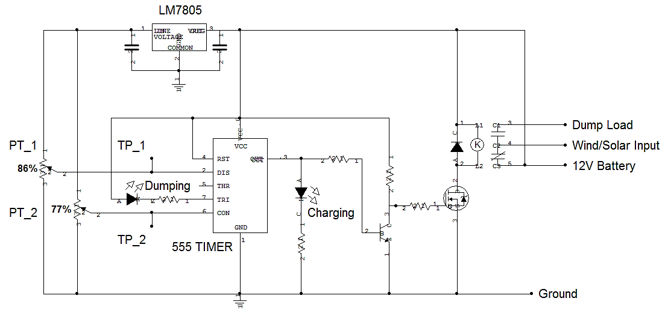
Diversion Charge Controller

Slide 27
Battery Bank
Attributes | Lead Acid | Li Ion | NaS | Ni-Cd | Zn-Br
Depth of Discharge | 75% | 80% | 100% | 100% | 100%
Cost | Low | Very High | High and auxiliary heating systems needed | High | High
Lifespan (Cycles) | 1000 | 3000 | 2500 | 3000 | 2000
Efficiency | 72-78% | 100% | 89% | 72-78% | 75%
Self-discharge | Average | Negligible | Negligible | High | Negligible
Maturity of Technology | Mature | Immature | Mature | Mature | Immature

Slide 28
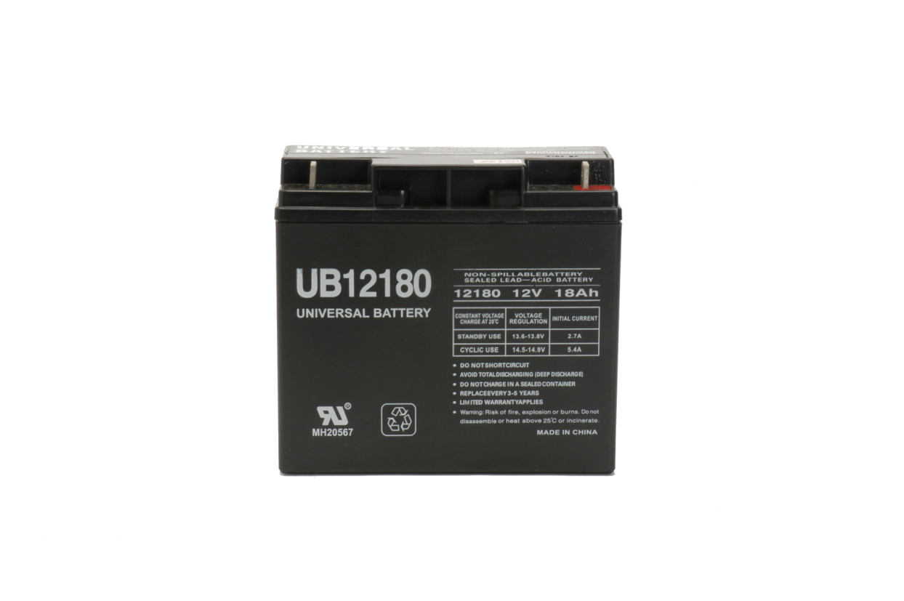
Battery Bank
Universal Power Group (UPG) UB12180 D5745 Sealed AGM-type Lead-Acid Battery
Nominal voltage: 12 volts
Periodically charge and discharge
Should be charged under constant voltage.
Durable
7.15 in
6.60 in
3.06 in

Slide 29
Testing- Voltage Monitoring
Wind Turbine
Input (V) | Output (V) | Ratio
9.8 | 1.50 | 6.533
10.2 | 1.50 | 6.8
10.5 | 1.55 | 6.77
10.7 | 1.61 | 6.65
11.3 | 1.68 | 6.73
12.7 | 1.87 | 6.79
13.0 | 1.91 | 6.8

Slide 30
Testing- Integrated Charge Mode
Integrated Solar

Slide 31
Testing- Charge

Slide 32
Testing- Integrated Charge Mode
Integrated Wind

Slide 33
Cost-Efficiency Analysis
Parts List | Cost per Part | Number of Parts | Total Cost
Printed Circuit Board (Student Special) | $33.00 | 2 | $66.00
DS1624 Temperature Sensor | $9.00 | 1 | FREE
Voltage Sensing Circuit | $3.49 | 1 | $3.49
LCD Screens | $29.95 | 1 | $29.95
Power P-Channel MOSFET | FREE | 6 | FREE
Atmel AT91SAM7X512 | $21.51 | 2 | FREE
Relay | $5.00 | 4 | $20.00
Bus | $5.00 | 1 | $5.00
Metal Box | $7.00 | 1 | $7.00
Cables and Wires | $20.00 |  | $20.00
Random Components | $40.00 |  | $40.00
300 Watt Dump Load for 12 Volt Systems | $21.98 | 2 | $43.96
 |  | Total: | $235.4

Slide 34
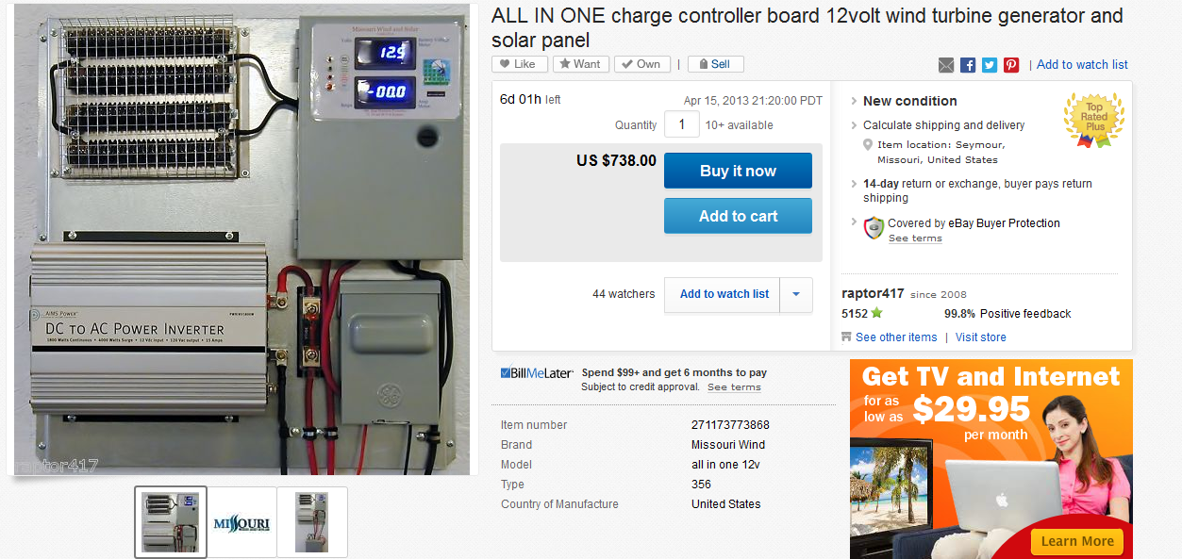
Cost-Efficiency Analysis

Slide 35
Parts List | Cost per Part | Number of Parts | Total Cost
SW-S85P Solar Panels | $249.85 | 1 | $249.85
Mounting Bracket | FREE | 1 | FREE
Hyacinth P-300W | $275 | 1 | $275
Morningstar SS- MPPT | $199.00 | 1 | $199.00
Printed Circuit Board (Student Special) | $33.00 | 2 | $66.00
DS1624 Temperature Sensor | $9.00 | 1 | FREE
Voltage Sensing Circuit | $3.49 | 1 | $3.49
LCD Screens | $29.95 | 1 | $29.95
UPG UB12180 AGM-type Battery | $38.35 | 2 | $76.70
300 Watt Dump Load for 12 Volt Systems | $21.98 | 3 | $65.94
Power P-Channel MOSFET | FREE | 6 | FREE
Atmel AT91SAM7X512 | $21.51 | 2 | FREE
Netduino | $34.95 | 1 | $34.95
Relay | $5.00 | 4 | $20.00
Bus | $5.00 | 1 | $5.00
Metal Box | $7.00 | 1 | $7.00
Cables and Wires | $20.00 |  | $20.00
Random Components | $40.00 |  | $40.00
 |  | Total: | $1092.88

Slide 36
Work Distribution
 | Karel | Dave | Julio | Jing
Switching Circuit |  | X | X
Volt Sensor |  | X | X
Current Sensor |  | X | X | X
Diversion Controller |  |  | X
PCB | X | X | X | X
Power Supply |  |  |  | X
User Interface | X
Programming | X

Slide 37
Lessons Learned
What works in simulation does not mean it works in the real world
Should always think few steps further
Backup is always needed

Slide 38
References
M. Chen, "The Integrated Operation of Renewable Power System," IEEE Canada Electrical Power Conference, 314-319, 2007.

Slide 39
Questions?

